Slide 1
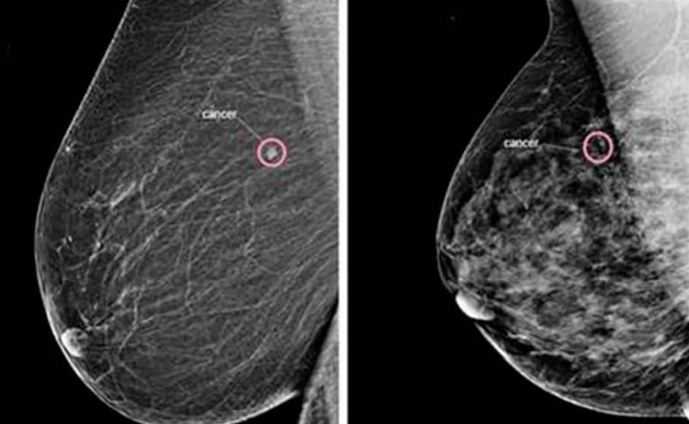
Mammography
Project
- Paul Yomer Ruiz Pinto (N10962646)
- Si Man Kou (N11200855)

Slide 2
Agenda
1.
Approach
2.
Findings

Slide 3

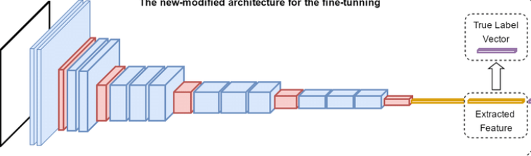
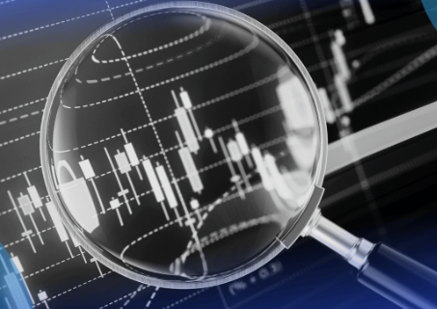
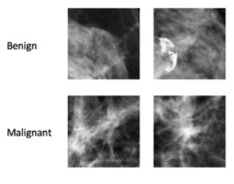

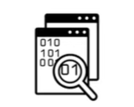
Methodology
Data preparation
Deep Learning Model Architectures
Experimental Setup and Analysis
Data collection and description
Limitations and assumptions of the method
Prediction
Notes:
The current slide outlines the workflow employed in our model research; we adopted the same approach. The process was divided into several key stages: Data Collection and Description, Data Preparation, Deep Learning Model Architectures, Experimental Setup and Analysis, and Discussion of Limitations and Assumptions.
Our primary contribution is centred on addressing a limitation identified in the previous study, specifically the need to apply their models to a new dataset. To address this challenge, we focused on enhancing data preparation and preprocessing, including the application of data augmentations.

Slide 4
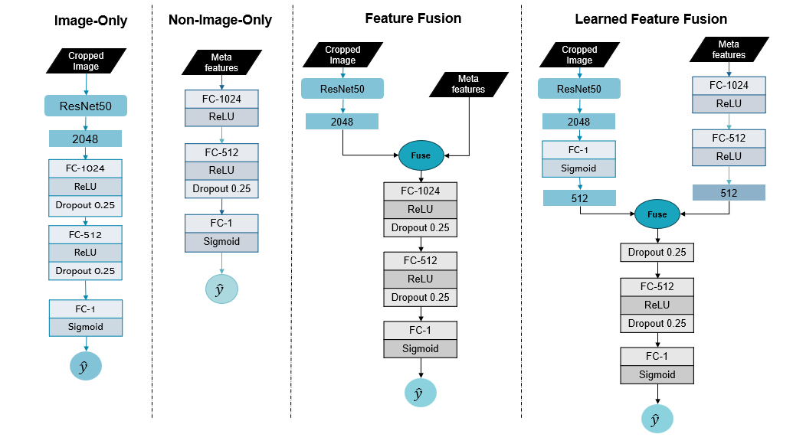
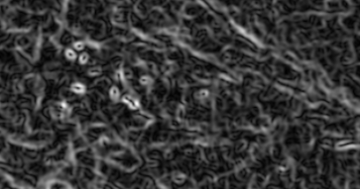
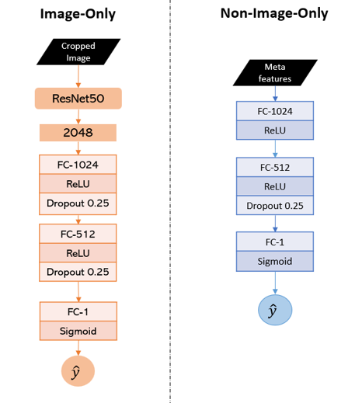

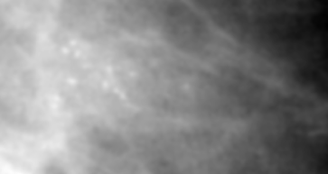
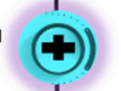

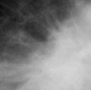

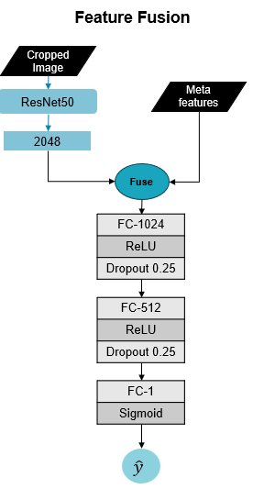
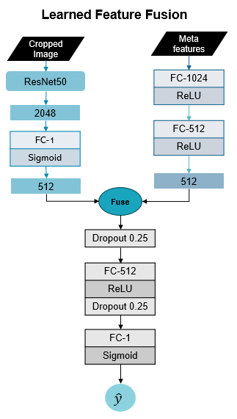
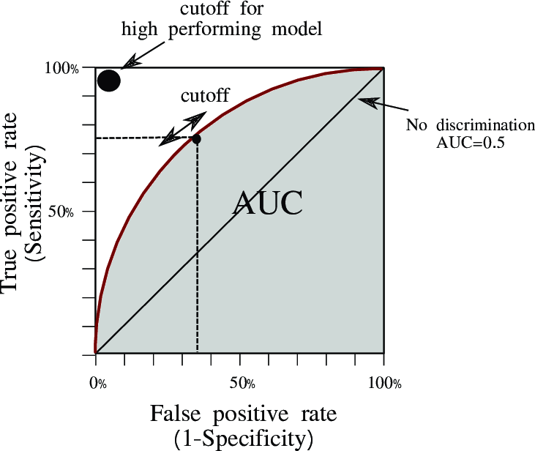

CBIS-DDSM Data Preparation
Pre-processing
Deep Learning Model Architectures
Final Prediction /
Experimental Setup and Analysis
1
2
3
4
Benign
Metadata evaluation: Calc/Mass
Loading data from files:
"_meta.npy“
"_x_cropped.npy“
"_y.npy"
Baseline models
Augment
Downsampling
Malignant
Resizing/Normalising
Concatenation/One-hot encoding
Fusion strategy
Train/Test/Validation Split
Experiment Varying Fusion Operation
Image Approach
Map images, metadata and target to CSV files
P < 0.05
Non-image Approach
Notes:
Now, let’s move into the phases of the study. In the Data Preparation phase, we began by assessing the available metadata. We identified two types of appearances saved as mass and calcification metadata. After evaluating each column and values in each file, we conducted downsampling. Subsequently, we concatenated all the datasets and applied one-hot encoding to all categorical variables. We then performed a train-test-validation split in a ratio of 6:2:2. Finally, we mapped the images, metadata, and target values, saving them as individual NumPy arrays with specific filenames in a designated directory.
The Data Preprocessing phase involved loading the data from each file, resizing and normalising to be used by the baseline and fusion models.
Let's now move into the Deep Learning Model Architectures phase. We have two baseline models, one utilising image data exclusively, and the other utilising non-image data. Additionally, we have two fusion models that combine image and non-image data. Let's explore these models in more detail.
First, Let’s focus on the similarities shared between the models. The models accept specific inputs: "meta_features" for the non-image-only model and a 2048-dimensional feature vector for the image-only model. Both models include three fully connected (linear) layers, each employing ReLU activation. A dropout layer is included to prevent overfitting.
Second, let's discuss the fusion strategy. The Feature Fusion model combines a 2048-feature vector from a breast image with the 33 non-image inputs. This combination is achieved by concatenating the non-image inputs onto the extracted feature vector before jointly learning from both image and non-image features to make a final prediction. In contrast, the Learned Feature Fusion simultaneously learns features from the breast image and non-image features, followed by concatenating them. Consequently, the model learns from this combined vector to produce a final prediction.
Now, in the final prediction phase. To enhance model robustness and introduce diversity, we applied data augmentation techniques such as blurring, scaling, resizing, and the "sobel filter" for edge detection.
In the Experimental Setup and Analysis phase, we utilized PyTorch to create and train our models. Model performance was evaluated based on AUC and a p-value less than 0.05.
Our main limitations are the artificiality introduced by image data augmentation, and assumptions made regarding the relevance of non-image features.

Slide 5
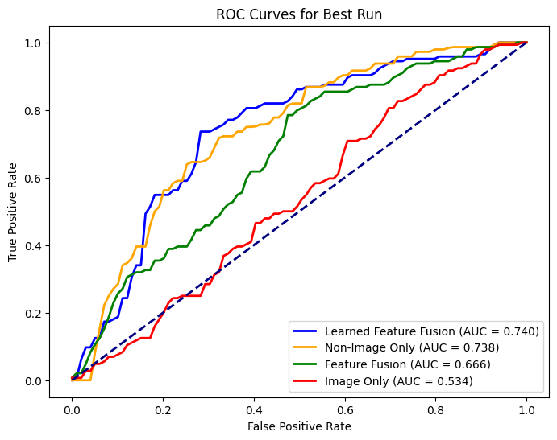
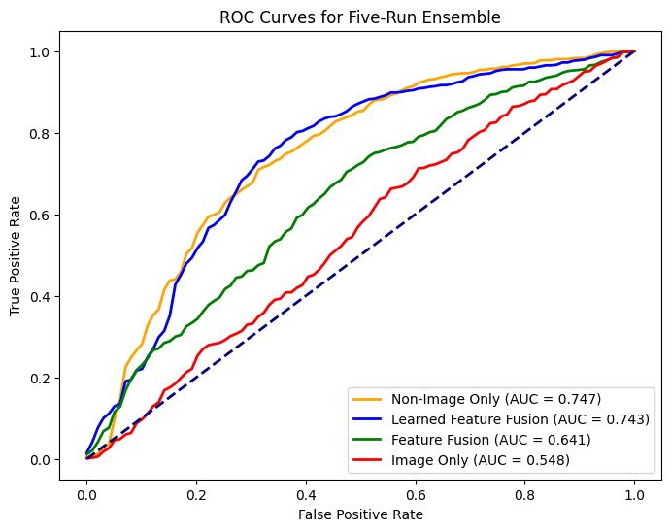
Results and Discussion
Inter-model classification performance summary:
image-only classifier is the least effective
Non-image-only is the best classifier, followed by the learned feature fusion, which outperforms non-image in best-run AUC by 2%, 95% CI and overall FNR by 2-4%
Learned feature fusion is the most effective fusion approach
Notes:
For the evaluation, we evaluated each of the four model architectures over the test set with a sample size of 288, using AUC (area under the curve) with 95% confidence intervals, False negative rate and the sensitivity (TPR) at 95% specificity to quantity how well the models classify subjects having condition of interest. Each model was trained 5 times with different number-generating seeds, the average values of all the evaluation metrics across five runs were calculated to represent the overall model performance, and the best run referring to the best run with the highest validation AUC.
Overall all, we observed that:
- image-only is the least effective classifier which performs almost like a random model
- non-image-only is the best-performing model in terms of sensitivity in both the best run and five-run ensemble and the ensemble AUC
- learned feature fusion is similar in terms of performance, however, outperform it by the best run AUC by 2%, 95% CI and overall FNR by 2-4%
- comparing across the fusion modality, learned feature fusion outperforms feature fusion with a significant improvement from image-only, suggesting that the joint learning of the learned features of non-image and image is more effective than learning raw non-image features.

Slide 6
Permutation-Based Non-Image Feature Importance
Approach: randomly shuffle the values of the associated binary columns per feature across all the test samples → generate new predictions for the permuted data → observe the resulting decrease in test AUC
Interpretation: Decrease in AUC = Importance
Image Fusion vs Non-Image
Lower contribution of abnormality characteristics following the integration of image features → non-images features can be partially learned from image features
Overall observations
Feature Fusion vs Learned Feature Fusion
Fusion of learned image features complements the non-image abnormality characteristics moderately without overwriting them → increased accuracy
mass margin, mass shape and calcification type consistently influenced the most in all models
most dominant in non-image-only with negative importance observed in other features
Notes:
we further conducted a permutation-based non-image feature importance analysis on the non-image meta features to understand the contribution of non-image features on model behaviours. To derive the importance score, randomly shuffled the values of the associated binary columns once per non-image feature across all the test samples, using which a new prediction and AUC score is generated. As such, we observed the resulting decrease in the test AUC. A higher importance value means a larger decrease in AUC observed, suggesting that the feature is more influential in contributing a good result.
Overall, it is observed that:
mass margin, mass shape and calcification type consistently influenced the most in all models, most dominant in non-image-only, with negative importance observed in other features
Comparing image fusion vs non-image only, lower contribution of these abnormality characteristics is observed in fusion model as a result of the image feature integration → shows that some non-image features have information that can be partially learnt directly from the image features and there is more opportunity for image features to compete with the non-image.
Lastly, we observe that the fusion of learned image features complements the non-image abnormality characteristics moderately without overwriting them -> shows that the combined non-image and image features are still important for an accurate prediction.
------------------------------------
Deprecated:
To understand more about the behaviour of the models by way of feature contribution, we further conducted a permutation-based non-image feature importance analysis on the non-image meta features to identify the most influential non-image features and the difference across the three models employing non-image features. To derive the importance score, randomly shuffled the values of the associated binary columns once per non-image feature across all the test samples, using which a new prediction and AUC score is generated for the permuted data. Lastly, we observed the resulting decrease in the test AUC to generate the absolute feature importance. A higher importance value implies a larger decrease in AUC observed, meaning the feature is more influential in the contribution of good prediction.
Overall, it is observed that:
mass margin, mass shape and calcification type consistently influenced the most in all models, most dominant in non-image-only with negative importance observed in other features
Comparing image fusion vs non-image only, lower contribution of these abnormality characteristics is observed in fusion model as a result of the image feature integration → shows that some non-image features have information that can be partially learnt directly from the image features, and that they are highly correlated with the non-image features. The hypothesis for a generally greater absolute importance values for virtually every feature in the unimodal model is that no image features are there for the model to ‘compete’ and there is more opportunity for image features to compete with the non-image.
Comparing feature fusion vs learned feature fusion, we found that the fusion of learned image features complements the non-image abnormality characteristics moderately without overwriting them -> shows that the combined non-image and image features are still important for an accurate prediction.

Slide 7
THANK YOU

